Slide 1
Dimensionality Reduction using Auto-Encoders
Dr. venkataramana veeramsetty

Slide 2
Dimensionality reduction
Dimensionality reduction is a technique used to reduce the number of features in a dataset while retaining as much of the important information as possible.
In other words, it is a process of transforming high-dimensional data into a lower-dimensional space that still preserves the essence of the original data.
This can be done for a variety of reasons, such as
To reduce the complexity of a model
To improve the performance of a learning algorithm
To make it easier to visualize the data.

Slide 3
Dimensionality reduction techniques
High-dimensional data can lead to overfitting, where the model fits the training data too closely and does not generalize well to new data, as complexity of the model increases with the number of features
Dimensionality reduction techniques
Feature Selection
Feature Extraction

Slide 4
Advantages of Dimensionality Reduction
It helps in data compression, and hence reduced storage space.
It reduces computation time.
It also helps remove redundant features, if any.
Improved Visualization
Overfitting Prevention

Slide 5
disadvantages of Dimensionality Reduction
It may lead to some amount of data loss.
It may be difficult to understand the relationship between the original features and the reduced dimensions.

Slide 6
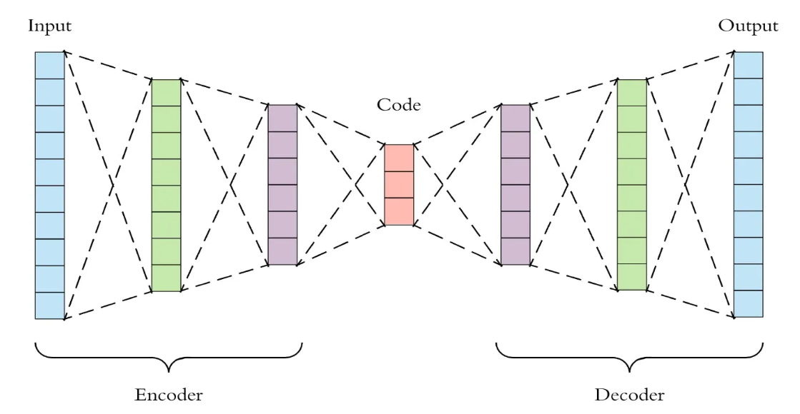
autoencoder
Auto-encoders are a branch of neural networks which basically compresses the information of the input variables into a reduced dimensional space and then it recreate the input data set to train it all over again.
Auto-encoder consists of 3 main components
Encoder
Code
Decoder

Slide 7
Auto-encoder components
Encoder: An encoder is a feed-forward, fully connected neural network that compresses the input into a latent space representation and encodes the input image as a compressed representation in a reduced dimension, and produces code.
Code: This part of the network contains the reduced representation of the input that is fed into the decoder.
Decoder: A decoder is also a feed-forward neural network that is similar to an encoder but the representation is the exact mirror image of the encoder. The decoder reconstructs the input back to the original dimensions from the code.

Slide 8
Process
First, the input passes through the encoder, which is a fully-connected ANN, to produce the code.
The decoder, which has the similar ANN structure, then produces the output only using the code.
The goal is to get an output identical with the input.
Decoder architecture is the mirror image of the encoder. This is not a requirement but it's typically the case.
The only requirement is the dimensionality of the input and output needs to be the same. Anything in the middle can be played with.

Slide 9
Hyperparameters
Code size: number of nodes in the middle layer. Smaller size results in more compression.
Number of layers: the auto-encoder can be as deep as we like. In the figure above we have 2 layers in both the encoder and decoder
Number of nodes per layer: The number of nodes per layer decreases with each subsequent layer of the encoder and increases back in the decoder.
Loss function: we either use mean squared error (mse) or binary cross-entropy. If the input values are in the range [0, 1] then we typically use cross-entropy, otherwise, we use the mean squared error.

Slide 10
Thank You

